Slide 1
CARDIOVASCULAR SYSTEM - INSPECTION
BRUSH UP

Slide 2
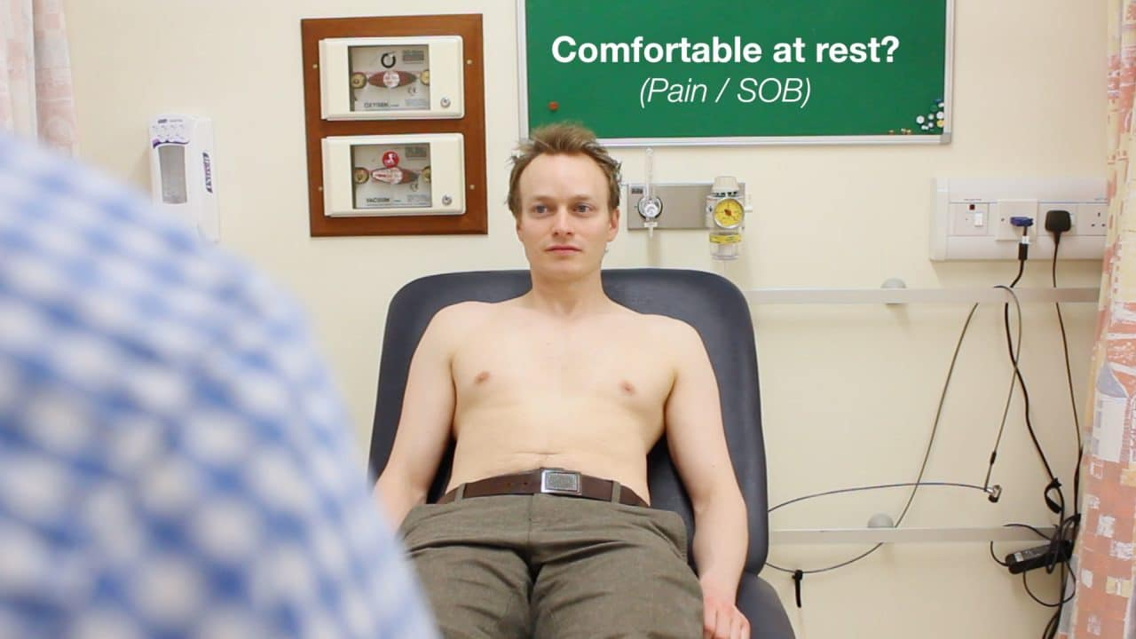
GENERAL APPROACH

Slide 3
GENERAL PHYSICAL EXAMINATION
ANEMIA
JAUNDICE
CYANOSIS
CLUBBING
LYMPHADENOPATHY
EDEMA

Slide 4
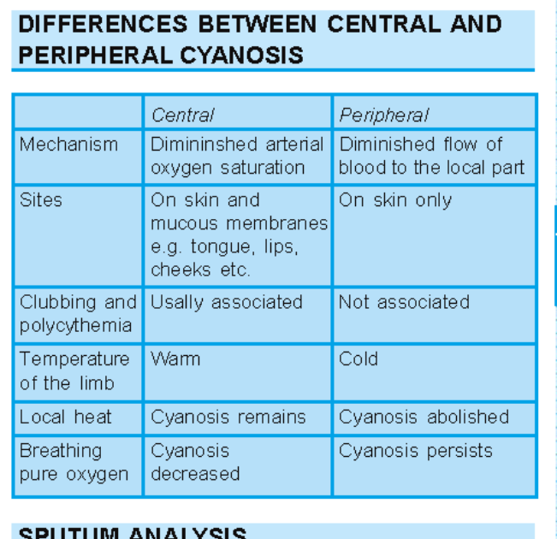

Slide 7
VITAL SIGNS
PULSE
BLOOD PRESSURE
RESPIRATORY RATE

Slide 9
INSPECTION
JUGULAR VENOUS PULSE AND PRESSURE
CHESTWALL DEFORMITY
SCARS
VISIBLE PULSATIONS
PRECORDIAL BULGE
DILATED VEINS

Slide 10
JUGULAR VENOUS PULSATION

Slide 12
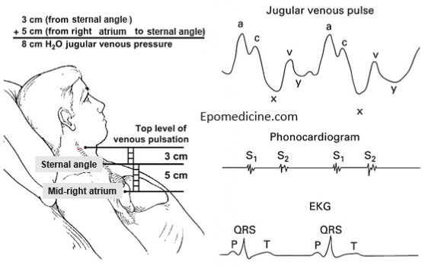
JUGULAR VENOUS PRESSURE

Slide 13
THANKYOU

